Slide 1

Chapter 18A Listing Biotech Companies on the Hong Kong Stock Exchange
January 2020
www.charltonslaw.com

Slide 2
INTRODUCTION
The Hong Kong Stock Exchange (the Exchange) published its Consultation Conclusions on a Listing Regime for Companies from Emerging and Innovative Sectors on 24 April 2018 (Consultation Conclusions) setting out Listing Rule changes which allow the listing on the Exchange of two new categories of company - (i) pre-revenue biotech companies and (ii) innovative and high growth issuers which have weighted voting rights (WVR) structures.
The new Rules took effect on 30 April 2018 and also create a new secondary listing route for innovative companies with primary listings on Qualifying Exchanges.

Slide 3
BACKGROUND
The aim of the Listing Rule changes for pre-revenue biotech companies is to attract listings of China’s new generation of biotech companies amid growing competition from the US and Chinese stock exchanges.
It is hoped that the rule changes will allow the Exchange to overtake NASDAQ within 5 years in terms of the number and market capitalisation of Chinese Biotech listings.
The Listing Rule changes aim to attract more listing applicants from the high-growth tech and biotech sectors, the Hong Kong market having been dominated in the past by old economy, low growth sectors, notably the financial and property sectors.
The financial requirements for listing on the Exchange have acted as a bar to listing biotech companies whose R&D costs typically mean that they do not make profits for some time.

Slide 4
LIST OF BIOTECH COMPANIES
Chapter 18A listco | Place of Incorporation | Stock Code & Link to Prospectus | Date of Prospectus
Ascletis Pharma Inc. | Cayman Islands | 1672 | 7/20/2018
BeiGene, Ltd. | Cayman Islands | 6160 | 7/30/2018
Hua Medicine | Cayman Islands | 2552 | 8/31/2018
Innovent Biologics, Inc. | Cayman Islands | 1801 | 10/18/2018
Shanghai Junshi Biosciences Co., Ltd. | PRC | 1877 | 12/11/2018
CStone Pharmaceuticals | Cayman Islands | 2616 | 2/14/2019
CanSino Biologics Inc. | PRC | 6185 | 3/18/2019
Mabpharm Ltd. | Cayman Islands | 2181 | 5/20/2019
Alphamab Oncology | Cayman Islands | 9966 | 9/2/2019
Shanghai Henlius Biotech Inc. | PRC | 2696 | 9/12/2019
Ascentage Pharma Group International | Cayman Islands | 6855 | 10/16/2019
TOT Biopharm International Co. Ltd. | Hong Kong | 1875 | 10/29/2019
SINOMAB BIO | Hong Kong | 3681 | 10/31/2019
Venus Medtech (Hangzhou) Inc. | PRC | 2500 | 11/28/2019
Innocare Pharma Ltd. | Cayman Islands | 9969 | 3/11/2020
Akeso, Inc. | Cayman Islands | 9926 | 4/14/2020
Peijia Medical Ltd. | Cayman Islands | 9996 | 5/5/2020
Kintor Pharmaceutical Ltd. | Cayman Islands | 9939 | 5/12/2020
Immunotech Biopharm Ltd. | Cayman Islands | 6978 | 6/29/2020
Ocumension Therapeutics | Cayman Islands | 1477 | 6/29/2020
JHBP (CY) Holdings Ltd. | Cayman Islands | 6998 | 9/23/2020
JW (Cayman) Therapeutics Co. Ltd | Cayman Islands | 2126 | 10/22/2020
Remegen Co., Ltd. | PRC | 9995 | 10/28/2020
Antengene Corporation Ltd. | Cayman Islands | 6996 | 11/9/2020
HBM Holdings Ltd. | Cayman Islands | 2142 | 11/30/2020
Jacobio Pharmaceuticals Group Co., Ltd. | Cayman Islands | 1167 | 12/9/2020
As of 13 January 2021
Source: https://www.hkex.com.hk/Market-Data/Securities-Prices/Equities?sc_lang=en

Slide 5
LISTING PRE-REVENUE BIOTECH COMPANIES
Introduction
The Exchange has added a new Chapter 18A to the Main Board Listing Rules (LR) for the listing of biotech companies which cannot meet the Main Board’s financial eligibility tests. Guidance on the factors the Exchange considers in determining listing applicants’ eligibility and suitability for listing under the new rules is set out in a new Guidance Letter HKEx-GL92-18 “Suitability for Listing of Biotech Companies” (the Biotech Guidance Letter) (Updated in October 2019 and April 2020)
Definition of "Biotech Companies“
Biotech Companies are defined as companies primarily engaged in the research and development (R&D), application and commercialisation of Biotech products, processes or technologies.
Biotech - “the application of science and technology to produce commercial
products with a medical or other biological application”.

Slide 6
LISTING REQUIREMENTS
Expected market capitalisation
Biotech Companies are required to have a minimum expected market capitalisation of HK$1.5 billion at listing (LR18A.03(2)).
Suitability for listing
In addition to the general requirement that the Exchange must consider the listing applicant and its business to be suitable for listing on the Exchange, Biotech companies must meet the following requirements set out in the Biotech Guidance Letter, to be considered suitable for listing under new Chapter 18A:
  development of at least one Core Product beyond the concept stage. The Exchange would consider a Core Product to have been developed beyond the concept stage if it has met the developmental milestones specified for the relevant type of product in paragraph 3.3 of the Biotech Guidance Letter;

Slide 7
LISTING REQUIREMENTS
  The following table sets out a summary of the stages at which different Biotech products are regarded as being beyond the concept stage.
Pharmaceutical (small molecule drugs)
1. Core products that are new pharmaceutical (small molecule) drugs | Applicant must demonstrate that (a) it has completed Phase I clinical trials – i.e. clinical trials on human subjects categorised as Phase 1 by the FDA (or an equivalent process by another Competent Authority) and (b) the relevant authority has no objection to the commencement of Phase II (or later) clinical trials. Phase II trials are those on human subjects as categorised by the FDA or other Competent Authority.
2. Core products that are pharmaceutical (small molecule drug) products which are based on previously approved products (e.g. the 505(b)(2) application process of the US FDA | Applicant must demonstrate that it has successfully completed at least one clinical trial conducted on human subjects, and that the relevant Competent Authority has no objection for it to commence Phase II (or later) clinical trials.
3. an in-licensed or acquired Core Product | the Exchange expects the Biotech Company to complete at least one clinical trial regulated by the relevant Competent Authority on human subjects since the in-licensing or acquisition. If the applicant has not completed at least one clinical trial for the in-licensed or acquired Core Product, the Exchange will evaluate why no clinical trial has been completed and whether substantive R&D work and process(es) equivalent to the completion of one clinical trial on human subjects have been performed by the Biotech Company. The Exchange will not consider any administrative process as substantive R&D work and process(es)

Slide 8
LISTING REQUIREMENTS
Biologics
1. Core Products that are new biologic products | The applicant must demonstrate that it has completed Phase I clinical trials and the relevant Competent Authority has no objection for it to commence Phase II (or later) clinical trials.
2. Core Products that are biosimilar | The applicant must demonstrate that it has completed at least one clinical trial on human subjects, and the relevant Competent Authority has no objection for it to commence Phase II (or later) clinical trials to demonstrate bio-equivalency.
3. an in-licensed or acquired Core Product | the Exchange expects the Biotech Company to complete at least one clinical trial regulated by the relevant Competent Authority on human subjects since the in-licensing or acquisition. If the applicant has not completed at least one clinical trial for the in-licensed or acquired Core Product, the Exchange will evaluate why no clinical trial has been completed and whether substantive R&D work and process(es) equivalent to the completion of one clinical trial on human subjects have been performed by the Biotech Company. The Exchange will not consider any administrative process as substantive R&D work and process(es)

Slide 9
LISTING REQUIREMENTS
Medical Devices (including diagnostics)
Core Products that are medical devices (which includes diagnostic devices), | The applicant must demonstrate that: the product is categorised as Class II medical device (under the classification criteria of the relevant Competent Authority) or above; it has completed at least one clinical trial on human subjects (which will form a key part of the application required by the Competent Authority or the Authorised Institution being an institution, body or committee duly authorised or recognised by a Competent Authority or the European Commission for conducting, assessing and supervising clinical trials in the relevant clinical fields. The Exchange has the discretion to recognise other institutions or bodies as Authorised Institutions); and either the Competent Authority or the Authorised Institution has endorsed or not expressed objection for the applicant to proceed to further clinical trials; or the Competent Authority (or, in the case of member(s) of the European Commission, an Authorised Institution) has no objection for the applicant to commence sales of the device.

Slide 10
LISTING REQUIREMENTS
Other Biotech Products
The Exchange considers other Biotech products on a case by case basis to determine if the applicant has demonstrated that the product has been developed beyond the concept stage by reference to factors referred to in paragraph 3.3 of the Biotech Guidance Letter and whether there is an appropriate framework or objective indicators to make an informed investment decision regarding the listing applicant. A determination to accept such a listing would be a modification that may only be made with the SFC’s consent under LR2.04. For applicants eligible to list under Chapter 18A, references to “Core Products” refer to the Biotech Product of the relevant listing applicant. The Exchange will categorise a Biotech Product as it is categorised by its Competent Authority. If a Biotech Product is regulated as a pharmaceutical, biologics, or medical device, a Biotech Company cannot re-classify such products as “Other Biotech Product” because it is unable to fulfil any of the requirements of the relevant category Where there is no regulatory regime which sets out external milestones or an objective framework to assess the development progress, market and clinical relevance of a product under the “Other Biotech Product” category, the Exchange will consider, for example, the number, selection process and diversity of the test sampling population, and availability of data from pre-clinical and clinical trials; time-frame and impediments to commercialisation; whether the pre-clinical and clinical results have been published in medical/scientific journals. The Exchange will take into account the impact factor of the journals; and where Competent Authorities have published relevant guidelines, their views and aspects of a comparable framework and/ or objective indicators of “Other Biotech Products”.

Slide 11
LISTING REQUIREMENTS
  primary engagement in R&D for developing its Core Product(s);
  engagement in the R&D of its Core Products for a minimum of 12 months prior to listing, including but not limited to:
    in the case of a Core Product which is in-licensed or acquired from third parties, the listing applicant must be able to demonstrate R&D progress since the in-licensing acquisition). For example, the applicant’s in-licensed or acquired products (1) progressed from preclinical stage to clinical stage, (2) progressed from one clinical phase to the next phase of clinical trial, or (3) obtained regulatory approval from the Competent Authority to market the Core Product; and
    in the case of a Core Product which has been commercialised in a given market for specified indication(s) and the Biotech Company intends to apply a portion of the listing proceeds to, for example, (1) expand the indications of the commercialised Biotech Product, or (2) launch it in another market, the Exchange would expect further R&D expended on the Core Product in connection with the clinical trials required by the Competent Authority to either bring the Core Product for (1) a new indication; or (2) commercialisation in a new regulated market

Slide 12
LISTING REQUIREMENTS
  the primary reason for listing must be the raising funds for R&D to bring its Core Product(s) to commercialization. For Biotech Companies that develop medical devices which have a short development cycle, the Exchange may take into account these Biotech Companies’ business plan and development stage of the pipeline products such that they may allocate a portion of listing proceeds to, for example, set up production facilities that will be primarily used for the manufacturing of Core Product(s) to bring it to commercialisation, and establish sales, marketing and medical teams to commercialise its Core Product(s)
  the applicant must have registered patent(s), patent application(s) and/or intellectual property in relation to its Core Product(s);
  if the applicant is engaged in R&D of pharmaceutical (small molecule drugs) products or biological products, there must be a pipeline of those potential products; and
  prior meaningful third party investment (being more than just a token investment) from at least one sophisticated investor at least six months before the proposed listing, and that investment continuing at listing. In the case of a spin-off listing from a parent company, the Exchange may not insist on compliance with this requirement where the applicant can otherwise demonstrate a reasonable degree of market acceptance for its R&D and Biotech Product.

Slide 13
LISTING REQUIREMENTS
  The Exchange assesses on a case-by-case basis whether an investor is a “sophisticated investor” for these purposes by reference to factors such as net assets and assets under management, relevant investment experience, and the investor’s knowledge and expertise in the relevant field. The Biotech Guidance Letter (paragraph 3.2(g)(i)) gives the following as examples of sophisticated investors:
    a dedicated healthcare or Biotech fund or an established fund with a division/department that invests in the biopharmaceutical sector;
    a major pharmaceutical/healthcare company;
    a venture capital fund of a major pharmaceutical/healthcare company; and
    an investor, investment fund or financial institution with minimum assets under management of HK$1 billion (increased from the HK$500,000 originally proposed).
  Whether a third party investment is meaningful is assessed case-by-case taking into account the nature of the investment, the amount invested, the size of the stake and timing of the investment. As an indicative benchmark, the Exchange gives the following as examples of investment amounts that are typically considered to be “meaningful investments”:
  Applicant’s market capitalisation Meaningful investment - % of the applicant’s
  issued share capital on listing
  HK$1.5 bln - HK$3 bln 5% or more
  HK$3 bln - HK$8 bln 3% or more
  > HK$8 billion 1% or more

Slide 14
LISTING REQUIREMENTS
Track Record
  Biotech Company listing applicants must have a track record of operating in their current line of business of at least 2 financial years prior to listing under substantially the same management (LR 18A.03(3)).
Ownership Continuity and Control
  The Exchange reviews any change in the applicant’s ownership within 12 months prior to the date of the listing application in assessing the applicant’s suitability for listing (Paragraph 4.1 of the Biotech Guidance Letter).
Working capital
  An applicant must have available working capital to cover at least 125% of the group’s costs for at least 12 months from the date of publication of the listing document (after taking into account the IPO proceeds) (LR 18A.03(4)). These costs should substantially consist of (a) general, administrative and operating costs, and (b) R&D costs. The Exchange expects a substantive portion of the IPO proceeds to be applied to these costs.

Slide 15
LISTING REQUIREMENTS
Subscription of shares by existing shareholders
Biotech Companies which list under Chapter 18A are expected to have significant ongoing funding needs to bring their Core Product(s) to commercialisation. Existing shareholders in Biotech Company listing applicants may wish to continue to participate in post-listing fundraisings to prevent their shareholdings being diluted. Given the likely funding needs of Biotech Companies and the important role played by existing shareholders in providing continuing funding, existing shareholders are allowed to participate in a Biotech Company’s IPO, provided that the company complies with the public float requirements of LR 8.08(1) and LR18A.07.
For the avoidance of doubt, the Existing Shareholders Conditions in GL85-16 do not apply to Biotech Companies. For example:
  an existing shareholder holding less than 10% of shares in the Biotech Company may subscribe for shares in the IPO as either a cornerstone investor or as a placee. In the case of subscription as a placee, the applicant and its sponsor must confirm that no preference in allocation was given to the existing shareholder. In the case of subscription as a cornerstone investor, the applicant and its sponsor must confirm that no preference was given to the existing shareholder other than the preferential treatment of assured entitlement at the IPO price and the terms must be substantially the same as other cornerstone investors.
  an existing shareholder holding 10% or more of shares in the Biotech Company may subscribe for shares in the IPO as a cornerstone investor

Slide 16
LISTING REQUIREMENTS
Pre-IPO Investments
An existing shareholder with a contractual anti-dilution right may exercise such right and subscribe for shares in the IPO in accordance with the existing requirements under paragraph 3.10 of GL43-12, as illustrated as follows:
Anti-dilution rights
May exercise before and in connection with an IPO: Exercise of anti-dilution rights by the pre-IPO investors in connection with the IPO is permissible if: (i) the allocation is necessary in order to give effect to the pre-existing contractual rights of the pre-IPO investors; full disclosure of the pre-existing contractual entitlement of the preIPO investors contained in the relevant investor rights agreement and the number of shares to be subscribed by the pre-IPO investors will be made in the listing document and the allotment results announcement; and the additional shares will be subscribed for at the offer price of the IPO offering. Must terminate upon listing: • Anti-dilution rights may not survive after listing to be in line with Main Board Rule 13.36 (GEM Rule 17.39) on pre-emptive rights.

Slide 17
LISTING REQUIREMENTS
Listing Rules 9.09 waiver
Where allocations will be made to core connected persons, the Biotech Company must apply for, and the Exchange will ordinarily grant, a related Rule 9.09 waiver, if applicable
LR9.09 is as follows:
“There must be no dealing in the securities for which listing is sought by any core connected person of the issuer (except as permitted by rule 7.11): (a) in the case of listing application by listed issuers, from the time of submission of the formal application for listing until listing is granted; and (b) in the case of a new applicant, from 4 clear business days before the expected hearing date until listing is granted. The directors of the issuer for whose securities listing is being sought shall forthwith notify the Exchange of any such dealing or suspected dealing of which they become aware. If any of the directors or their close associates are found to have engaged in such dealing, the application may be rejected.”

Slide 18
ENHANCED DISCLOSURE REQUIREMENTS
Biotech applicants must provide enhanced risk disclosure in listing documents, including information relating to:
    their strategic objectives;
    details of each Core Product, including:
      a description of the Core Product;
      details of any relevant regulatory approval required and/or obtained for each Core Product;
      a summary of material communications with the relevant Competent Authority in relation to its Core Product(s) (unless disclosure is not permitted under applicable laws or regulations, or the directions of the Competent Authority);
      the stage of research and development for each Core Product;
      development details by key stages and its requirements for each Core Product to reach commercialisation, and a general indication of the likely timeframe, if the development is successful, for the product to reach commercialisation;
      all material safety data relating to its Core Product(s), including any serious adverse events;
      a description of the immediate market opportunity of each Core Product if it proceeds to commercialization and any potential increased market opportunity in the future (including a general description of the competition in the potential market);

Slide 19
ENHANCED DISCLOSURE REQUIREMENTS
      details of patent(s) granted, registered and applied for in relation to the Core Product(s) (unless the applicant is able to demonstrate to the satisfaction of the Exchange that such disclosure would require the applicant to disclose highly sensitive commercial information) or an appropriate negative statement;
      in the case of a Core Product which is biologics, disclosure of planned capacity and production related technology details; and
      to the extent that any Core Product is in-licensed, a clear statement of the issuer’s material rights and obligations under the applicable licensing agreement;
  a statement that no material unexpected or adverse changes have occurred since the date of issue of the relevant regulatory approval for a Core Product (if any). Any material changes must be prominently disclosed;
  a description of any Approved Products owned by the listing applicant and the length of unexpired patent protection period and details of current and expected market competitors;

Slide 20
ENHANCED DISCLOSURE REQUIREMENTS
  details of the Biotech Company’s R&D experience including:
  details of its operations in laboratory R&D;
  the collective expertise and experience of key management and technical staff; and
  its collaborative development and research agreements;
  details of the relevant experience of the Biotech Company’s directors and senior management in the research and development, manufacturing and commercialisation of Biotech Products;
  the salient terms of any service agreements between the listing applicant and its key management and technical staff;
  measures (if any) that the applicant has in place to retain key management or technical staff (e.g. incentivisation arrangements and/or non-compete clauses), and the safeguards and arrangements that the applicant has in place, in the event of the departure of any of its key management or technical staff;
  a statement of any legal claims or proceedings that may have an influence on its research and development for any Core Product;

Slide 21
ENHANCED DISCLOSURE REQUIREMENTS
  disclosure of specific risks, general risks and dependencies, including:
    potential risks in clinical trials;
    risks associated with the approval process for its Core Product(s); and
    the extent to which its business is dependent on key individuals and the impact of the departure of key management or technical staff on the applicant’s business operations;
  if relevant and material to the Biotech Company’s business operations, information on:
    project risks arising from environmental, social, and health and safety issues;
    compliance with host country laws, regulations and permits, and payments made to
    host country governments in respect of tax, royalties and other significant payments
    on a country by country basis;
    its historical experience of dealing with host country laws and practices,
    including management of differences between national and local practice; and
    its historical experience of dealing with the concerns of local governments
    and communities on the sites of its research and trials, and relevant management arrangements;

Slide 22
ENHANCED DISCLOSURE REQUIREMENTS
  an estimate of cash operating costs, including costs related to R&D and clinical trials incurred in the development of the Core Products and costs associated with:
    workforce employment;
    direct production costs, including materials (if it has commenced production);
    R&D;
    product marketing (if any);
    non-income taxes, royalties and other governmental charges (if any);
    contingency allowances; and
    any other significant costs.
    In particular, Biotech Companies are required to: (a) set out the components of cash operating costs separately by category; (b) explain the reason for any departure from the list of items to be included under cash operating costs; and (c) discuss any material cost items that should be highlighted to investors;
  if the applicant has obtained an expert technical assessment, that assessment should be included in the listing document where relevant and appropriate; and
  listing documents must include a prominent warning statement in respect of each Core Product that it may not ultimately be successfully developed and marketed.

Slide 23
CONTINUING OBLIGATIONS OF
LISTED BIOTECH COMPANIES
Financial Report Disclosure
Biotech Companies must disclose in their annual and half-year reports details of R&D activities including:
  details of the key stages of each of its Core Products under development to reach commercialisation and a general indication of the likely timeframe for it to reach commercialisation;
  a summary of expenditure incurred on R&D activities; and
  a prominently disclosed warning that a Core Product may not ultimately be successfully developed and marketed.
  Delisting
The Exchange has the power to suspend dealings in the shares of a Biotech Company which does not maintain sufficient operations or assets as required by LR13.24, or may cancel its listing under LR6.01. The Exchange can also give a company up to 12 months to comply with LR13.24, after which its listing will be cancelled if it is still in breach (LR18A.09).
Prohibition on fundamental change in business
Listed Biotech Companies require the Exchange’s consent for any acquisition, disposal or other transaction or arrangement (or a series of such transactions) that would result in a fundamental change to the company’s principal business activities as described in its listing document (LR18A.10).

Slide 24
CONTINUING OBLIGATIONS OF
LISTED BIOTECH COMPANIES
Stock Marker
Stock names of listed Biotech Companies have the marker “B” at the end of their name (LR18A.11).
Meeting the Main Board financial eligibility tests
Once a listed Biotech Company is able to satisfy the financial eligibility tests under LR 8.05, LR 18A.09 to LR18A.11 will cease to apply (i.e. sufficiency of operations, Exchange’s consent requirement for material change in business and stock marker requirement).
Biotech companies are a new sector for Hong Kong listings having previously been prevented from listing by the financial eligibility requirements for profits, revenue and cash flow. The first listings of Biotech companies are expected to occur as early as summer 2018 and there is already a pipeline of Biotech companies that have expressed an interest in listing in Hong Kong. Applicants have been able to submit listing applications since 30 April 2018.

Slide 25

CHARLTONS
Charltons’ extensive experience in corporate finance makes us uniquely qualified to provide a first class legal service
Charltons have representative offices in Shanghai, Beijing and Yangon
Charltons was named the “Corporate Finance Law Firm of the Year in Hong Kong ” in the Corporate Intl Magazine Global Award 2014
“Boutique Firm of the Year” / “Boutique Transactional Law Firm of the Year” was awarded to Charltons by Asian Legal Business for the years 2002, 2003 and 2006 to 2017 (inclusive)
“Hong Kong's Top Independent Law Firm” was awarded to Charltons in the Euromoney Legal Media Group Asia Women in Business Law Awards 2012 and 2013
“Equity Market Deal of the Year” was awarded to Charltons in 2011 by Asian Legal Business for advising on the AIA IPO

Slide 26
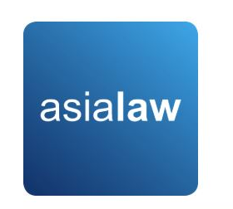
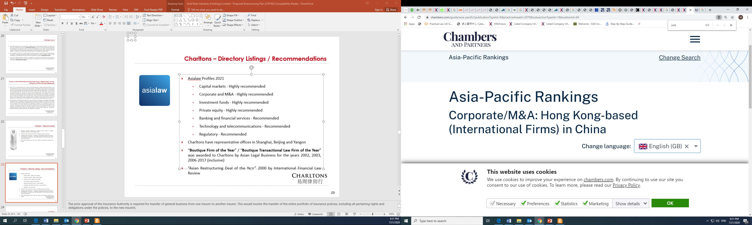
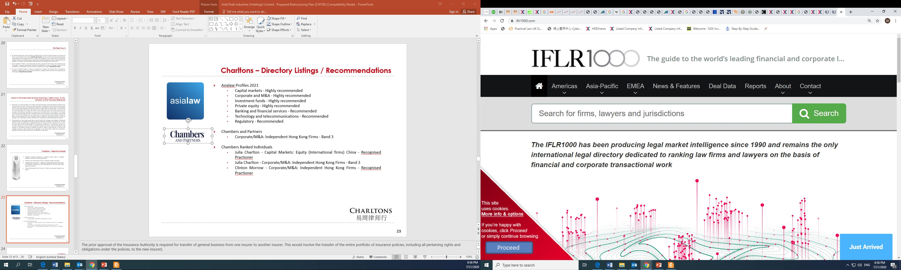
CHARLTONS – DIRECTORY LISTINGS / RECOMMENDATIONS
Asialaw Profiles 2021
  Capital markets - Highly recommended
  Corporate and M&A - Highly recommended
  Investment funds - Highly recommended
  Private equity - Highly recommended
  Banking and financial services - Recommended
  Technology and telecommunications - Recommended
  Regulatory - Recommended
Chambers and Partners
  Corporate/M&A: Independent Hong Kong Firms - Band 3
  Chambers Ranked Individuals
  Julia Charlton - Capital Markets: Equity (International firms) China - Recognised Practitioner
  Julia Charlton - Corporate/M&A: Independent Hong Kong Firms - Band 3
  Clinton Morrow - Corporate/M&A: Independent Hong Kong Firms - Recognised Practitioner
  IFLR1000
  Capital markets : Equity - Other notable
  M&A - Other notable
  IFLR1000 Ranked Individuals
  Julia Charlton - Highly regarded

Slide 27




CHARLTONS
Excellent links and networks with law firms worldwide.
Julia Charlton was:
  named a “Leading Lawyer” by Asia Law & Practice for the years 2002, 2003, 2006-2020 (inclusive)
  awarded ‘Hong Kong Capital Markets Lawyer of the Year’ by Finance Monthly Global Awards 2014.
  named a ‘Leading Advisor’ by Acquisition International for 2013.
  awarded the American Chamber of Commerce of Hong Kong / South China Morning Post Women of Influence: Professional of the Year 2008.
  finalist of Veuve Clicquot Business Woman Award 2018 Hong Kong

Slide 28

PRACTICE AREAS
Capital markets
Corporate and commercial
Securities
Mergers and acquisitions
Investment funds: China and offshore
Derivatives
Restructuring
Venture capital
Investment

Slide 29
PRACTICE AREAS
Capital Markets
  Global offerings and GDRs
  IPOs and Placings
  Listing on the Hong Kong, Shanghai, Shenzhen, London and Luxembourg stock exchanges
Corporate and Commercial
  Mergers and Acquisitions
  Joint ventures
  Stock exchange advisory
  Corporate governance
  Stock options
  Employment law
Securities
  Compliance and disclosure
  Dealing and advisory authorisations in Hong Kong and Mainland China
  Options
Investment Funds: China and Offshore
  Authorised and unauthorised funds
  Stock exchange listing (including Hong Kong, Dublin, London, Cayman, Bermuda stock exchanges)
  Closed-end and open-ended structures
  Hedge funds
Mergers and Acquisitions
  Hong Kong Code on Takeovers and Mergers
  Public offerings
  Reverse takeovers
  Private acquisitions
  Due diligence in China and elsewhere in Asia
Derivatives
  Structuring listed and unlisted derivatives
  Placings on Hong Kong and Luxembourg listed warrants and other structured products
  Compliance and regulatory
Restructuring
  Schemes of arrangement
  Workouts
  Corporate recovery
  Asset injections
Investment
  China investment regulations
  Structuring a major foreign direct investment projects
  Evaluation and due diligence
Private Equity and Venture Capital
  Optimum PRC and offshore structures
  Preferred stock financing
  PRC regulations
  Exit Strategies

Slide 30

OUR SERVICES
Our services include:
  As the company’s lawyer, principal responsibilities include, inter alia:
    advising the company on the relevant listing and regulatory requirements in Hong Kong
    advising on any reorganisation plans and share option schemes
    assisting the company to prepare all relevant documents for the listing, including the prospectus (upon request), deeds, directors’ undertakings, service contracts, appointment letters, committee terms of reference, waiver applications, connected transaction analysis and submissions and other applicable documents
    issuance of legal opinions
    assisting the company to prepare for due diligence to be conducted by the sponsor
    conducting directors’ training
    coordinating with legal adviser of relevant jurisdictions
    liaising with the Stock Exchange on behalf of the company

Slide 31
OUR SERVICES
  As the sponsor’s lawyer, principal responsibilities include, inter alia:
    advising the sponsor and underwriters on the relevant Hong Kong legal and regulatory requirements in connection with the proposed listing
    assisting the sponsor to conduct due diligence on the company
    reviewing due diligence documents and conducting verification of the prospectus and coordinating with the auditor in relation to verification of financial information
    preparing the listing application, submissions, checklists and other documents required to be submitted
    Preparing documentation and advising on the marketing, underwriting, syndication, stabilization etc. of the share offering
    preparing sections of the prospectus
    preparing response to regulators over vetting process
    reviewing all documents and disclosures prepared by the company’s lawyer

Slide 32
THE CHARLTONS TEAM
The team is composed of individuals with the following knowledge, skills and experience:
  A detailed knowledge of Hong Kong law and practice in relation to IPOs and equity fund raising transactions of public companies.
  Extensive experience in providing legal services for Hong Kong and PRC-related IPO transactions.
  In depth knowledge of the Listing Rules of both GEM and the Main Board of the Hong Kong Stock Exchange.
  Depth and range of experience in advising companies in connection with IPO and listing transactions.

Slide 33

TEAM PROFILE: JULIA CHARLTON
Julia Charlton – Partner
  Julia, LL.B (1st class Honours), A.K.C (Kings College, London) was admitted as a solicitor in England & Wales in 1985 and has practised as a solicitor in Hong Kong since 1987.
  Julia is a member of the Takeovers Panel and the Takeovers Appeal Panel of the SFC, and served the maximum permitted term as a member of the Listing Committee of the Stock Exchange of Hong Kong Limited for six years from 2012 to 2018.
  Julia was named a “Leading Lawyer” by Asia Law & Practice for the years 2002, 2003, and 2006 to 2017.
  Julia was named a “Leading Advisor” by Acquisition International for 2013.
  Julia was also named the “Capital Markets Lawyer of the Year – Hong Kong” in the Finance Monthly Global Awards 2014.
  Julia has extensive experience in China work and is a Mandarin speaker.

Slide 34

TEAM PROFILE: CALVIN HO
Calvin Ho – Partner
  Calvin, Bachelor of Laws (LL.B) & Bachelor of Commerce (B.Com) (University of Melbourne), was admitted as solicitor in Hong Kong since 2009
  Calvin is a capital markets lawyer who regularly advises on IPOs, spin-offs, pre-IPO consultations, review and appeals as well as other related matter. Selected experience include:
  advised AIA Group Limited (1299) in connection with regulatory aspects of listing on the Main Board (Equity Market Deal of the Year, 2011 ALB Awards Hong Kong)
  advised United Company RUSAL Plc (486), one of the world’s largest aluminium company, on legal and regulatory aspects of its listing on Main Board as well as post-listing transactions (including very substantial transactions, redomiciliation etc.) and other ongoing legal and compliance issues
  advised on successful listing of True Partner Capital Holdings Limited (8657), Fu Shek Financial Holdings Ltd (2263) Excalibur Global Financial Holdings (8350), Zhi Sheng Group Holdings Ltd (8370), Medicskin Holdings Limited (8307), China Singyes New Materials Holdings Ltd (8073) etc. and transfer of listing of from GEM to Main Board of KVB Kunlun Holdings Limited (6877)

Slide 35
PROFESSIONAL EXPERIENCE
Charltons has considerable experience in advising companies or sponsors in relation to listings on the Main Board or the GEM of the Hong Kong Stock Exchange, and has extensive experience in bringing both private and state-owned Chinese enterprises to market
The following slides sets out selected IPO experience of Charltons. In addition to these IPOs, Charltons is often considered specialists in the field and is often engaged to advise on complex IPO-related matters, some of which involves extensive consultations, negotiations and dialogue with the Hong Kong regulators. By way of example, recently, we have been involved in:
advised the proposed spin-off on the Main Board of the steel processing, distribution and recycling businesses from the listed parent company engaged in real estate and property development, involving complex issues leading to appeals on various levels of the Listing Committee of the Stock Exchange
advised on the proposed spin-off on the Main Board of reproductive healthcare services business of a financial conglomerate which involved technical regulatory and valuation issues requiring extensive consultation with the Stock Exchange

Slide 36
PROFESSIONAL EXPERIENCE
advised as HK counsel and regulatory specialist in connection with the proposed listing on Main Board (and subsequently proposed U.S. listing) of Bitmain, the largest cryptocurrency mining hardware company and operator of mining pools involving highly complex regulatory advice and due diligence
advised on the proposed spin-off on the Main Board of application software services business from the parent company engaged in solutions and integration services which involved extensive negotiation with Stock Exchange on valuation and delineation issues
currently advising on the possible relaunch of an IPO by a financial services provider which has attempted and failed to list on the Main Board (previously on GEM) of the Stock Exchange due to complex regulatory issues
currently advising the sponsor on due diligence enquiries from the regulators concerning an lapsed listing application on the Main Board by a cement producer involving technical issues
As capital market lawyers, we are also heavily involved in post-listing compliance and regulatory issues as well as restructurings and privatisations involving listed entities. For example, we advised the managing director in relation to the privatisation of Hopewell, and is currently advising on a number of other privatisations, redomiciliation and restructurings involving prominent listed groups.

Slide 37


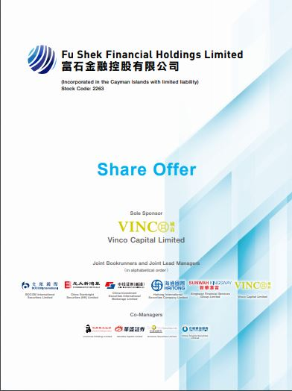
EXAMPLES OF IPO EXPERIENCE
True Partner Capital Holding Limited (listed on the the GEM of the SEHK in October 2020), Charltons acted as the Hong Kong legal adviser to the sponsor and underwriters)
Fu Shek Financial Holdings Limited (listed on the Main Board of the SEHK) in February 2020, Charltons acted as Hong Kong legal adviser to sponsor and underwriters)
Tianli Education International Holdings Limited (listed on the Main Board of the SEHK in July 2018, Charltons acted as the Hong Kong legal adviser to the sponsor and underwriters)

Slide 38
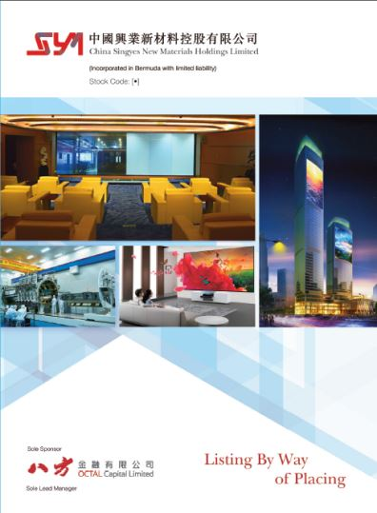

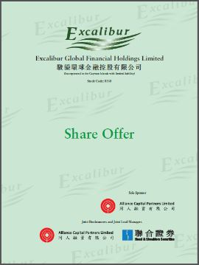
EXAMPLES OF IPO EXPERIENCE
Excalibur Global Financial Holdings Limited (listed on the GEM of the SEHK in January 2018, Charltons acted as the Hong Kong legal adviser to the sponsor and underwriters)
China Singyes New Materials Holdings Limited (listed on the GEM of the SEHK in June 2017, Charltons acted as the Hong Kong legal adviser to the sponsor and underwriters in connection with spins-off and listing)
Tree Holdings Limited (listed on the GEM of the SEHK, Charltons acted as the Hong Kong legal adviser to the sponsor and underwriters)

Slide 39
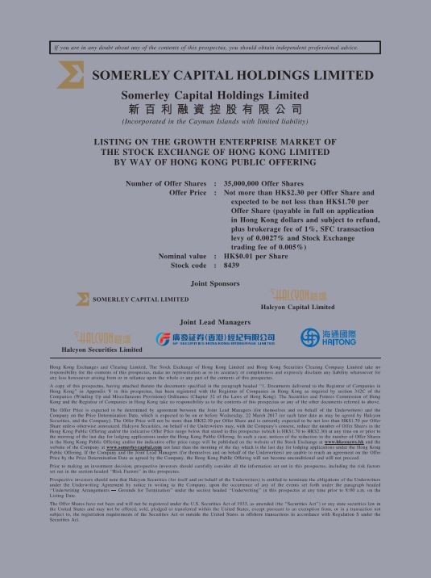
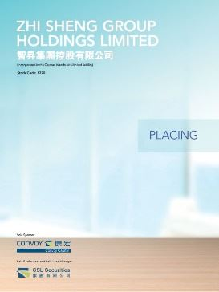
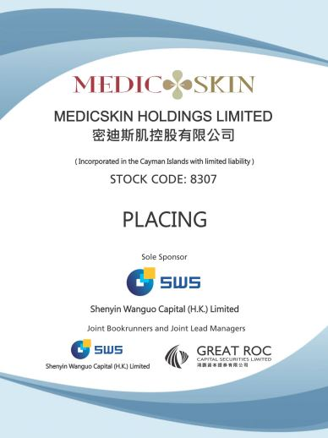
EXAMPLES OF IPO EXPERIENCE
Somerley Capital Holdings Limited (listed on the GEM of the SEHK in March 2017, Charltons acted as the Hong Kong legal adviser to the company)
Zhi Sheng Group Holdings Limited (listed on the GEM of the SEHK in January 2017, Charltons acted as the Hong Kong legal adviser to the sponsor and underwriters)
Medicskin Holdings Limited (listed on the GEM of the SEHK in December 2014, Charltons acted as the Hong Kong legal adviser to the company)

Slide 40
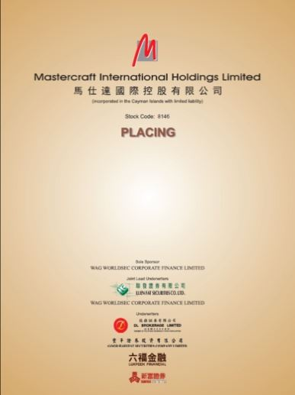

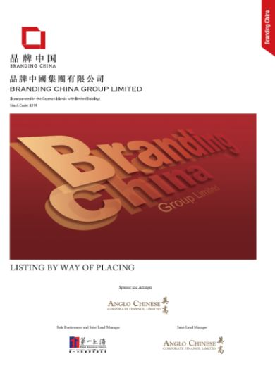
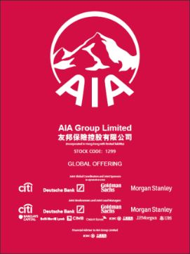
EXAMPLES OF IPO EXPERIENCE
Orient Securities International Holdings Limited (listed on the GEM of the SEHK in January 2014, Charltons acted as the Hong Kong legal adviser to the sponsor and underwriters)
Mastercraft International Holdings Limited (listed on the GEM of the SEHK, Charltons acted as the Hong Kong legal adviser to the sponsor and underwriters)
Branding China Group Limited (listed on the GEM of the SEHK, Charltons acted as the Hong Kong legal adviser to the sponsor and underwriters)
AIA Group Ltd. (listed on the Main Board of the SEHK , Charltons acted as the Hong Kong legal adviser to AIG, the controlling shareholder)

Slide 41



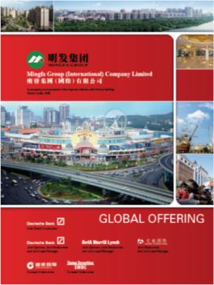
EXAMPLES OF IPO EXPERIENCE
United Company RUSAL Plc (listed on the Main Board of the SEHK, Charltons acted as the Hong Kong legal adviser to the controlling shareholder)
China Titans Energy Technology Group Co., Limited (listed on the Main Board of the SEHK , Charltons acted as the Hong Kong legal adviser to the sponsor and underwriters)
Mingfa Group (International) Company Limited (listed on the Main Board of the SEHK , Charltons acted as the Hong Kong legal adviser to the company)
Greens Holdings Limited (listed on the Main Board of the SEHK, Charltons acted as the Hong Kong legal adviser to the company)

Slide 42


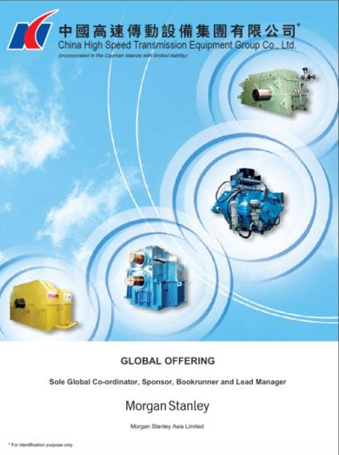
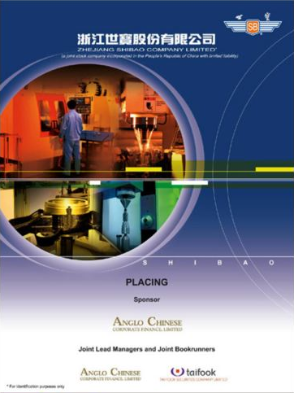
EXAMPLES OF IPO EXPERIENCE
China All Access (Holdings) Limited (listed on the Main Board of the SEHK, Charltons acted as the Hong Kong legal adviser to the sponsor and underwriters)
China Tianyi Fruit Holdings Limited (listed on the Main Board of the SEHK, Charltons acted as the Hong Kong legal adviser to the sponsor and underwriters)
China High Speed Transmission Equipment Group Co., Ltd. (listed on the Main Board of the SEHK, Charltons acted on behalf of the company)
Zhejiang Shibao Co., Ltd. (listed on the GEM of the SEHK, Charltons acted as the Hong Kong legal adviser to the company)

Slide 43
OTHER IPO EXPERIENCE
Fu Ji Food and Catering Services Holding Ltd. (listed on the Main Board of the SEHK, Charltons represented the strategic investor)
China Fire Safety Enterprise Group Holdings Ltd. - previously named Fujian Wanyou Fire Safety Technology Holdings Ltd. - (listed on the GEM of the SEHK, Charltons represented the strategic investor)
Shanghai Fudan-Zhangjiang Bio-Pharmaceutical Co. Ltd. (listed on GEM of the SEHK, Charltons acted as the Hong Kong legal adviser to the sponsor)
Tianjin TEDA Biomedical Engineering Co. Ltd. (listed on GEM of the SEHK, Charltons acted as the Hong Kong legal adviser to the sponsor)
Zheda Lande Scitech Ltd. (listed on GEM of the SEHK, Charltons acted as the Hong Kong legal adviser to the company)
Merdeka Resources Holdings Ltd. - previously named TradeEasy Holdings Ltd. - (listed on GEM of the SEHK, Charltons acted as the Hong Kong legal adviser to the company)
E. Bon Holdings Ltd. (listed on the Main Board of the SEHK, Charltons acted as the Hong Kong legal adviser to the sponsor)
Great Wall Technology Co. Ltd. (listed on the Main Board of the SEHK, Charltons acted as the Hong Kong legal adviser to the company)

Slide 44


CONTACT US
Hong Kong
12th Floor, Dominion Centre
43 – 59 Queen’s Road East
Hong Kong
Telephone: (852) 2905 7888
Facsimile: (852) 2854 9596
Email: enquiries@charltonslaw.com
Website: www.charltonslaw.com
In association with:-
China
Beijing Representative Office
3-1703, Vantone Centre
A6# Chaowai Avenue
Chaoyang District
Beijing
People's Republic of China
100020
Telephone: (86) 10 5907 3299
Facsimile: (86) 10 5907 3299
Email: enquiries.beijing@charltonslaw.com
Shanghai Representative Office
Room 2006, 20th Floor
Fortune Times
1438 North Shanxi Road
Shanghai
People's Republic of China
200060
Telephone: (86) 21 6277 9899
Facsimile: (86) 21 6277 7899
Email: enquiries.shanghai@charltonslaw.com
Networked with:-
Myanmar
Yangon Office of Charltons Legal Consulting Ltd
161, 50th Street
Yangon
Myanmar
Email: enquiries.myanmar@charltonslaw.com

Slide 45
DISCLAIMERS
This presentation is prepared by Charltons based on the information available to Charltons and not for public circulation. All the information is not independently verified by Charltons.
Charltons does not accept responsibility or liability for any loss or damage suffered or incurred by you or any other person or entity however caused (including, without limitation, negligence) relating in any way to this presentation including, without limitation, the information contained in or provided in connection with it, any errors or omissions from it however caused (including without limitation, where caused by third parties), lack of accuracy, completeness, currency or reliability or you, or any other person or entity, placing any reliance on this presentation, its accuracy, completeness, currency or reliability. Charltons does not accept any responsibility for any matters arising out of this presentation.
As a Hong Kong legal adviser, Charltons is only qualified to advise on Hong Kong law and we express no views as to the laws of any other jurisdictions. All the references to foreign laws herein are for information only and may not be up-to-date.

